Slide 1
CH 10: Graphs

Slide 2
Content
CH 10
Graphs and Graph Models
Graph Terminology and Special Types of Graphs
Representing Graphs and Graph Isomorphism
Connectivity

Slide 3
Representing Graphs and Graph Isomorphism
In this section we will show how to represent graphs in several different ways.
Two graphs are isomorphic if two graphs have exactly the same form
there is a one-to-one correspondence between their vertex sets that preserves edges.

Slide 4
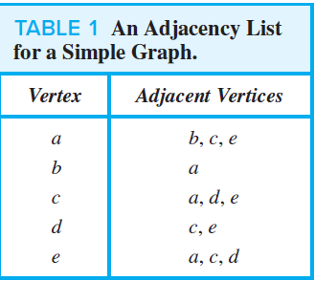
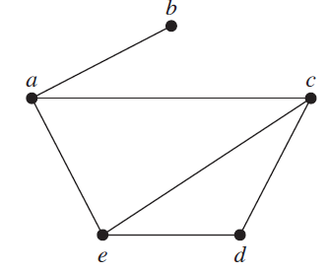
Representing Graphs and Graph Isomorphism
We represent graphs with no multiple edges using adjacency lists.
Example 1: Use adjacency lists to describe the simple graph

Slide 5
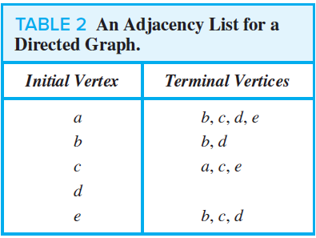
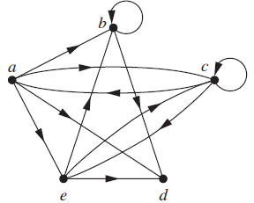
Representing Graphs and Graph Isomorphism
Example 2: Represent the directed graph shown by listing all the vertices that are the terminal vertices of edges starting at each vertex of the graph.

Slide 6
Representing Graphs and Graph Isomorphism
To simplify computation, graphs can be represented using matrices.
Two types of matrices commonly used to represent graphs.
Adjacency matrix.
Incidence matrix.

Slide 7


Representing Graphs and Graph Isomorphism
The adjacency matrix $A$ (or $A_{G}$) of G is the $n x n$ zero–one matrix with 1 as its ${\left(i, j\right)}^{th}$ entry when $v_{i}$ and $v_{j}$ are adjacent, and 0 as its ${\left(i, j\right)}^{th}$ entry when they are not adjacent.
$n$ is the number of vertices in a graph.

Slide 8
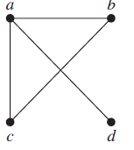
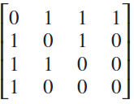
Representing Graphs and Graph Isomorphism
EXAMPLE 3: Use an adjacency matrix to represent the graph.
Solution: We order the vertices as a, b, c, d.

Slide 9
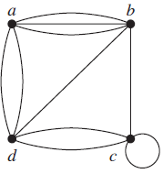
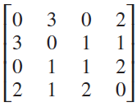
Representing Graphs and Graph Isomorphism
EXAMPLE 5: Use an adjacency matrix to represent the pseudograph
Solution: The adjacency matrix using the ordering of vertices a, b, c, d is

Slide 10


Representing Graphs and Graph Isomorphism
Let $G=(V, E)$ be an undirected graph. Suppose that $v_{1}, v_{2},…, v_{n}$ are the vertices and $e_{1}, e_{2},…, e_{m}$ are the edges of $G$. Then the incidence matrix is the $n×m$ matrix $M=[m_{ij}]$, where

Slide 11
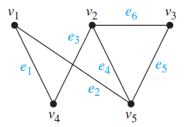
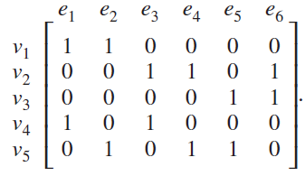
Representing Graphs and Graph Isomorphism
EXAMPLE 6: Represent the graph shown with an incidence matrix.
Solution: The incidence matrix is

Slide 12
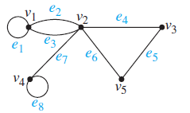
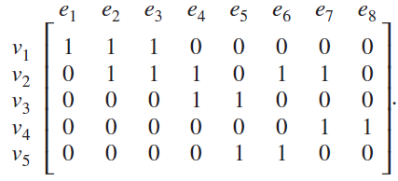
Representing Graphs and Graph Isomorphism
EXAMPLE 7: Represent the pseudograph shown using an incidence matrix.
Solution: The incidence matrix is

Slide 13

Representing Graphs and Graph Isomorphism
DEFINITION 1: The simple graphs $G_{1}=(V_{1}, E_{1})$ and $G_{2}=(V_{2}, E_{2})$ are isomorphic if there exists a one-to one and onto function $f$ from $V_{1}$ to $V_{2}$ with the property that $a$ and $b$ are adjacent in $G_{1}$ if and only if $f(a)$ and $f(b)$ are adjacent in $G_{2}$, for all $a$ and $b$ in $V_{1}$. Such a function $f$ is called an isomorphism.
Two simple graphs that are not isomorphic are called nonisomorphic.

Slide 14

Representing Graphs and Graph Isomorphism
DEFINITION 1: The simple graphs $G_{1}=(V_{1}, E_{1})$ and $G_{2}=(V_{2}, E_{2})$ are isomorphic if there exists a one-to one and onto function $f$ from $V_{1}$ to $V_{2}$ with the property that $a$ and $b$ are adjacent in $G_{1}$ if and only if $f(a)$ and $f(b)$ are adjacent in $G_{2}$, for all $a$ and $b$ in $V_{1}$. Such a function $f$ is called an isomorphism.
Two simple graphs that are not isomorphic are called nonisomorphic.
when two simple graphs are isomorphic, there is a one-to-one correspondence between vertices of the two graphs that preserves the adjacency relationship.

Slide 15
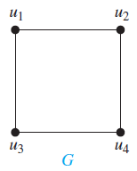
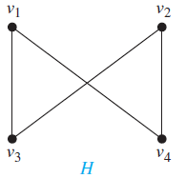

Representing Graphs and Graph Isomorphism
EXAMPLE 8: Show that the graphs G = (V, E) and H = (W, F) are isomorphic.
Solution: The function $f$ with $f(u_{1})=v_{1}$, $f(u_{2})=v_{4}$, $f(u_{3}) = v_{3}$, and $f(u_{4}) =v_{2}$ is a one-to-one correspondence between $V$ and $W$. The adjacent vertices in $G$ are $u_{1}$ and $u_{2}$, $u_{1}$ and $u_{3}$, $u_{2}$ and $u_{4}$, and $u_{3}$ and $u_{4}$, and each of the pairs $f(u_{1})=v_{1}$ and $f(u_{2})=v_{4}$, $f(u_{1})=v_{1}$ and $f(u_{3})=v_{3}$, $f(u_{2})=v_{4}$ and $f(u_{4})=v_{2}$, and $f(u_{3})=v_{3}$ and $f(u_{4})=v_{2}$ consists of two adjacent vertices in $H$.

Slide 16
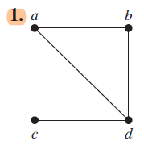
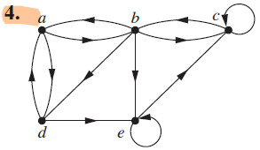
Exercises
In Exercises 1–4 use an adjacency list to represent the given graph.

Slide 17
Exercises
In Exercises 1–4 use an adjacency list to represent the given graph.
Vertex | Adjacent
a | b; d
b | a; c; d; e
c | b; c
d | a; e
e | c; e
Vertex | Adjacent
a | b, c, d
b | a, d
c | a, d
d | a, b, c

Slide 18
Exercises
5. Represent the graph in Exercise 1 with an adjacency matrix.

Slide 19
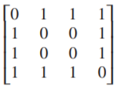
Exercises
5. Represent the graph in Exercise 1 with an adjacency matrix.

Slide 20

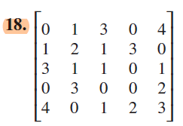
Exercises
In Exercises 16–18 draw an undirected graph represented by the given adjacency matrix.

Slide 21
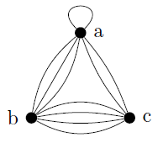
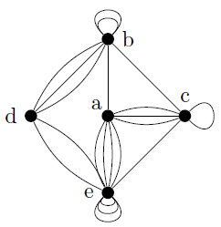
Exercises
In Exercises 16–18 draw an undirected graph represented by the given adjacency matrix.
Because of the numbers larger than 1, we need multiple edges in this graph.

Slide 22
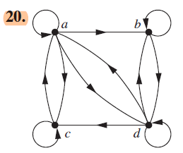
Exercises
In Exercises 19–21 find the adjacency matrix of the given directed multigraph with respect to the vertices listed in alphabetic order.

Slide 23
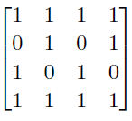
Exercises
In Exercises 19–21 find the adjacency matrix of the given directed multigraph with respect to the vertices listed in alphabetic order.

Slide 24
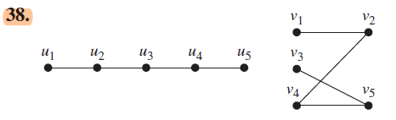
Exercises
In Exercises 38–48 determine whether the given pair of graphs is isomorphic.

Slide 25

Exercises
In Exercises 38–48 determine whether the given pair of graphs is isomorphic.
These graphs are isomorphic, since each is a path with five vertices. $f(u_{1})=v_{1} , f(u_{2})=v_{2} , f(u_{3})=v_{4} , f(u_{4})=v_{5} , and f(u_{5})=v_{3}.$

Slide 26
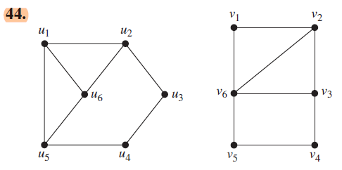
Exercises
In Exercises 38–48 determine whether the given pair of graphs is isomorphic.

Slide 27
Exercises
In Exercises 38–48 determine whether the given pair of graphs is isomorphic.
These graphs are not isomorphic - the degrees of the vertices are not the same (the graph on the right has a vertex of degree 4, which the graph on the left lacks).

Slide 28
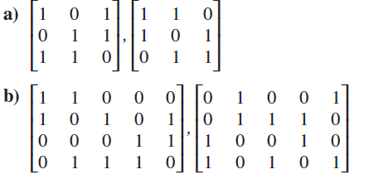
Exercises
64. Determine whether the graphs without loops with these incidence matrices are isomorphic.

Slide 29












Exercises
Create adjacency matrix for each graph
$$v_{1}$$
$$v_{2}$$
$$v_{3}$$
$$u_{1}$$
$$u_{2}$$
$$u_{3}$$
$$v_{1}$$
0 | 1 | 1
1 | 0 | 1
1 | 1 | 0
$$u_{1}$$
0 | 1 | 1
1 | 0 | 1
1 | 1 | 0
$$v_{2}$$
$$u_{2}$$
$$v_{3}$$
$$u_{3}$$
Both graphs have the same adjacency matrix. The graphs are isomorphic.

Slide 30
















Exercises
Create adjacency matrix for each graph
$$v_{1}$$
$$v_{2}$$
$$v_{3}$$
$$v_{4}$$
$$u_{1}$$
$$u_{2}$$
$$u_{3}$$
$$u_{4}$$
$$v_{1}$$
0 | 1 | 0 | 1
1 | 0 | 1 | 1
0 | 1 | 0 | 1
1 | 1 | 1 | 0
$$u_{1}$$
0 | 1 | 0 | 1
1 | 0 | 1 | 1
0 | 1 | 0 | 1
1 | 1 | 1 | 0
$$v_{2}$$
$$u_{2}$$
$$v_{3}$$
$$u_{3}$$
$$v_{4}$$
$$u_{4}$$
Both graphs have the same adjacency matrix. The graphs are isomorphic.

Slide 31
TASK
Section 10.3
2
3
6
17
19
39
45

Slide 32
Content
CH 10
Graphs and Graph Models
Graph Terminology and Special Types of Graphs
Representing Graphs and Graph Isomorphism
Connectivity

Slide 33

Connectivity
DEFINITION 1: Let $n$ be a nonnegative integer and $G$ an undirected graph. A path of length $n$ from $u$ to $v$ in $G$ is a sequence of $n$ edges $e_{1}, … , e_{n}$of $G$ for which there exists a sequence $x_{0}=u, x_{1}, … , x_{n−1}, x_{n}=v$of vertices such that $e_{i}$ has, for $i=1, … , n$, the endpoints $x_{i−1}$ and $x_{i}$. When the graph is simple, we denote this path by its vertex sequence $x_{0}, x_{1}, … , x_{n}$ (because listing these vertices uniquely determines the path). The path is a circuit if it begins and ends at the same vertex, that is, if $u = v$, and has length greater than zero. The path or circuit is said to pass through the vertices $x_{1}, x_{2}, … , x_{n−1}$ or traverse the edges $e_{1}, e_{2}, … , e_{n}$. A path or circuit is simple if it does not contain the same edge more than once.

Slide 34

Connectivity
DEFINITION 1: Let $n$ be a nonnegative integer and $G$ an undirected graph. A path of length $n$ from $u$ to $v$ in $G$ is a sequence of $n$ edges $e_{1}, … , e_{n}$of $G$ for which there exists a sequence $x_{0}=u, x_{1}, … , x_{n−1}, x_{n}=v$of vertices such that $e_{i}$ has, for $i=1, … , n$, the endpoints $x_{i−1}$ and $x_{i}$. When the graph is simple, we denote this path by its vertex sequence $x_{0}, x_{1}, … , x_{n}$ (because listing these vertices uniquely determines the path). The path is a circuit if it begins and ends at the same vertex, that is, if $u=v$, and has length greater than zero. The path or circuit is said to pass through the vertices $x_{1}, x_{2}, … , x_{n−1}$ or traverse the edges $e_{1}, e_{2}, … , e_{n}$. A path or circuit is simple if it does not contain the same edge more than once.
A path is a sequence of edges that begins at a vertex of a graph and travels from vertex to vertex along edges of the graph. As the path travels along its edges, it visits the vertices along this path, that is, the endpoints of these edges.

Slide 35
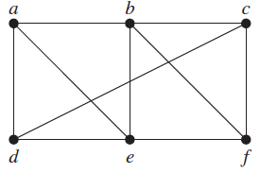

Connectivity
EXAMPLE 1:
$a, d, c, f, e$is a simple path of length 4, because $\{a, d\}, \{d, c\}, \{c, f\}, and \{f, e\}$ are all edges.
$d, e, c, a$ is not a path, because {e, c} is not an edge.
$b, c, f, e, b$ is a circuit of length 4 because $\{b, c\}, \{c, f \}, \{f, e\}, and \{e, b\}$ are edges, and this path begins and ends at $b$.

Slide 36
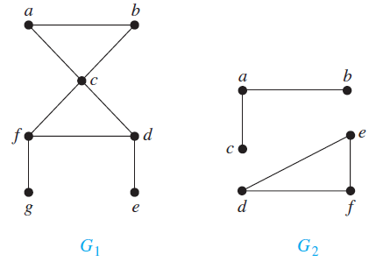
Connectivity
DEFINITION 3: An undirected graph is called connected if there is a path between every pair of distinct vertices of the graph. An undirected graph that is not connected is called disconnected.
We say that we disconnect a graph when we remove vertices or edges, or both, to produce a disconnected subgraph.

Slide 37
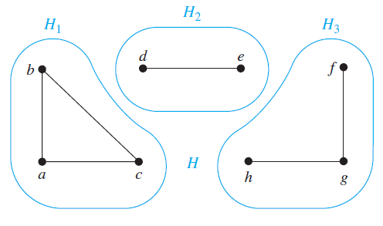
Connectivity
A connected component of a graph G is a connected subgraph of G that is not a proper subgraph of another connected subgraph of G.

Slide 38
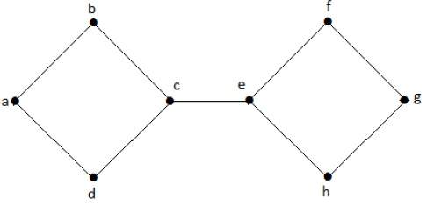
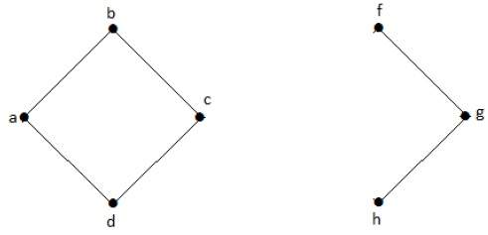
Connectivity
Cut vertices (or articulation points) is a vertex that when removed (with its boundary edges) from a graph creates more components than previously in the graph.

Slide 39
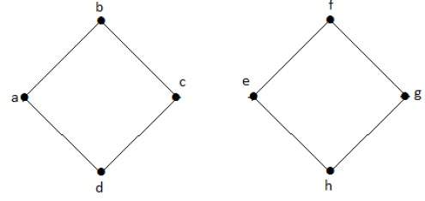
Connectivity
A cut edge (or bridge) is an edge that when removed (the vertices stay in place) from a graph creates more components than previously in the graph.

Slide 40

Connectivity
Connectedness in Directed Graphs
DEFINITION 4: A directed graph is strongly connected if there is a path from $a$ to $b$ and from $b$ to $a$ whenever $a$ and $b$ are vertices in the graph.
For a directed graph to be strongly connected there must be a sequence of directed edges from any vertex in the graph to any other vertex.
DEFINITION 5: A directed graph is weakly connected if there is a path between every two vertices in the underlying undirected graph.
A directed graph is weakly connected if and only if there is always a path between two vertices when the directions of the edges are disregarded.

Slide 41
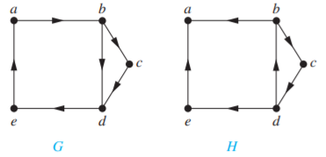

Connectivity
Example:
$G$ is strongly connected because there is a path between any two vertices in this directed graph. $G$ is also weakly connected. The graph $H$ is not strongly connected. There is no directed path from $a$ to $b$ in this graph. However, $H$ is weakly connected, because there is a path between any two vertices in the underlying undirected graph of $H$.

Slide 42
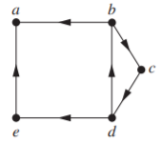

Connectivity
Strongly connected components (or strong components) of $G$: The subgraphs of a directed graph $G$ that are strongly connected but not contained in larger strongly connected subgraphs.
The graph has three strongly connected components, consisting of the vertex a; the vertex e; and the subgraph consisting of the vertices b, c, and d and edges (b, c), (c, d), and (d, b).

Slide 43
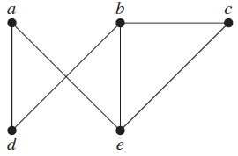
Exercises
1. Does each of these lists of vertices form a path in the following graph? Which paths are simple? Which are circuits? What are the lengths of those that are paths?
a) a, e, b, c, b b) a, e, a, d, b, c, a
c) e, b, a, d, b, e d) c, b, d, a, e, c

Slide 44
Exercises
1. Does each of these lists of vertices form a path in the following graph? Which paths are simple? Which are circuits? What are the lengths of those that are paths?
a) a, e, b, c, b b) a, e, a, d, b, c, a
c) e, b, a, d, b, e d) c, b, d, a, e, c
a) Path of length 4; not a circuit; not simple
b) Not a path
c) Not a path
d) Simple circuit of length 5

Slide 45
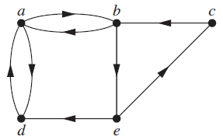
Exercises
2. Does each of these lists of vertices form a path in the following graph? Which paths are simple? Which are circuits? What are the lengths of those that are paths?
a) a, b, e, c, b b) a, d, a, d, a
c) a, d, b, e, a d) a, b, e, c, b, d, a

Slide 46
Exercises
2. Does each of these lists of vertices form a path in the following graph? Which paths are simple? Which are circuits? What are the lengths of those that are paths?
a) a, b, e, c, b b) a, d, a, d, a
c) a, d, b, e, a d) a, b, e, c, b, d, a
a) This is a path of length 4, but it is not a circuit. It is simple, since no edges are repeated.
b) This is a path of length 4, which is a circuit. It is not simple, since it uses an edge more than once.
c) This is not a path, since there is no edge from d to b.
d) This is not a path, since there is no edge from b to d.

Slide 47

Exercises
determine whether the given graph is connected.

Slide 48
Exercises
determine whether the given graph is connected.
This graph is connected. There is a path from every vertex to every other vertex.

Slide 49
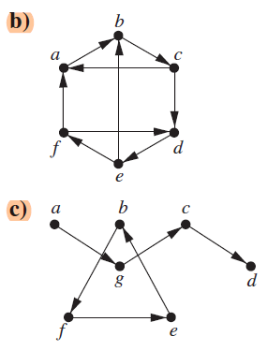
Exercises
12. Determine whether each of these graphs is strongly connected and if not, whether it is weakly connected.

Slide 50
Exercises
12. Determine whether each of these graphs is strongly connected and if not, whether it is weakly connected.
b) The sequence a, b, c, d, e, f, a provides a path from every vertex to every other vertex, so this graph is strongly connected.
c) The underlying undirected graph is clearly not connected, so this graph is neither strongly nor weakly connected.

Slide 51
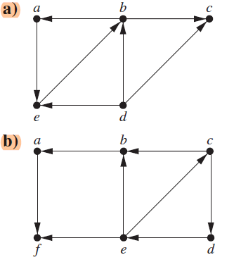
Exercises
14. Find the strongly connected components of each of these graphs.

Slide 52

Exercises
14. Find the strongly connected components of each of these graphs.
a) The cycle baeb guarantees that these three vertices are in one strongly connected component. Since there is no path from c to any other vertex, and there is no path from any other vertex to d, these two vertices are in strong components by themselves. Therefore the strongly connected components are $\{a,b,e\}$, $\{c\}$ and $\{d\}$.

Slide 53

Exercises
14. Find the strongly connected components of each of these graphs.
b) The cycle cdec guarantees that these three vertices are in one strongly connected component. The vertices a, b, and f are in strong components by themselves, since there are no paths both to and from each of these to every other vertex. Therefore the strongly connected components are $\{c,d,e\}$, $\{a\}$, $\{b\}$, $\{f\}$

Slide 54
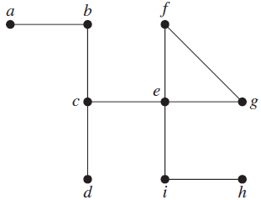
Exercises
Find all the cut vertices of the given graph.

Slide 55
Exercises
Find all the cut vertices of the given graph.
The cut vertices are b, c, e, i. The removal of either one creates a graph with two components. The removal of any other vertex does not disconnect the graph.

Slide 56
TASK
Section 10.4
3
12 (a)
14 (c)
31

